Slide 1
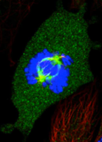
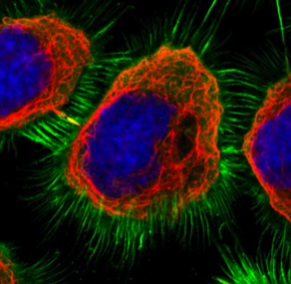
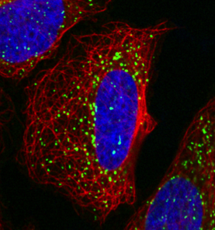
The Human Protein Atlas - implications for human biology, drug development and precision medicine
Systems biology course
October 2, 2018
Mathias Uhlen
Science for Life Laboratory (KI and KTH)
Stockholm, Sweden

Slide 2
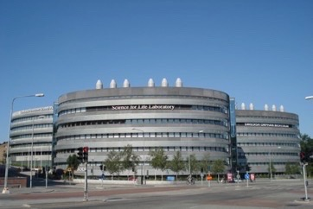
Science for Life Laboratory
A national infrastructure for next-generation life science
Global trends:
Need for major infrastructures
Technology evolving rapidly
Big data
Founding Director:
Mathias Uhlen

Slide 3
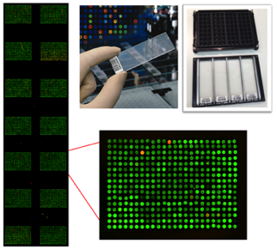

SciLifeLab
National Infrastructure for Molecular Biosciences
1 200 researchers, 3000 service projects in 2017

Slide 4
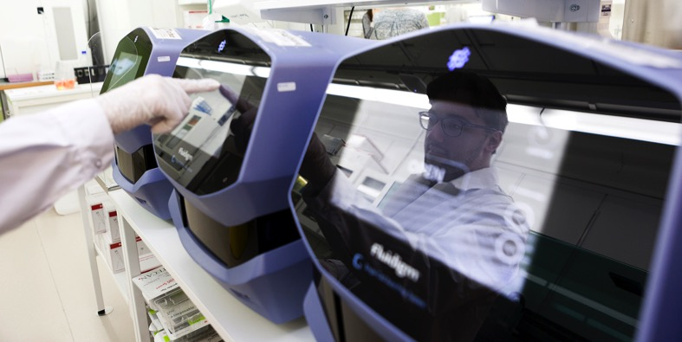
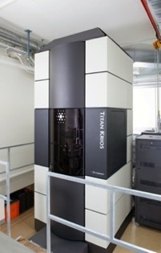
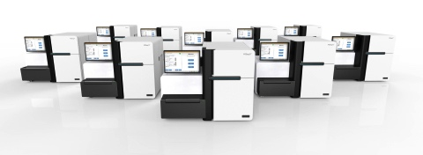
Example of infrastructure
Microfluidic processors for single-cell analysis
Super-resolution cryo-based
electron microscope
Hiseq-X Ten for whole genome sequencing (WGS)

Slide 5
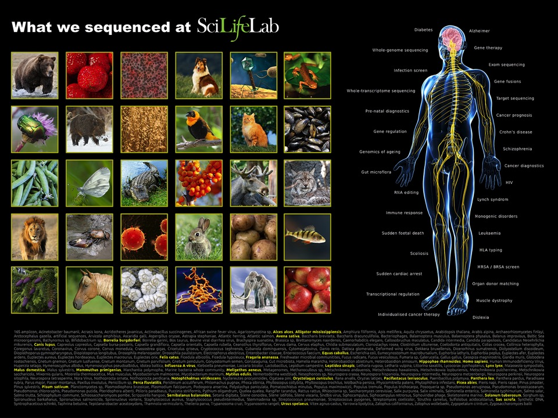

Slide 6
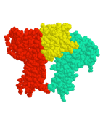
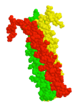
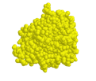
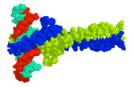
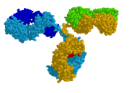
Proteins – the building-blocks of life
Catalysis
Signaling
Structure
Regulation
Defense
Enzymes
Receptors
Collagen
Transcription factors
Antibodies
Map all the human proteins : funding from the Wallenberg Foundation (2003-)
Notes:
----- Meeting Notes (9/29/15 02:46) -----
GOAL TO STUDY THE ENTIRE HUMAN PROTEOME!

Slide 7
Mapping of the building-blocks of humans
Initiative | Funding
Human Protein Atlas (Europe) | Wallenberg Foundation
Allen Cell Atlas Institute (US) | Paul Allen (Microsoft)
Biohub Cell Atlas (US) | Chan-Zuckerberg (Facebook)
Project Baseline - Verily (US) | Google
Watson Health (US) | IBM
Human Cell Atlas (US, Europe) | Various

Slide 8
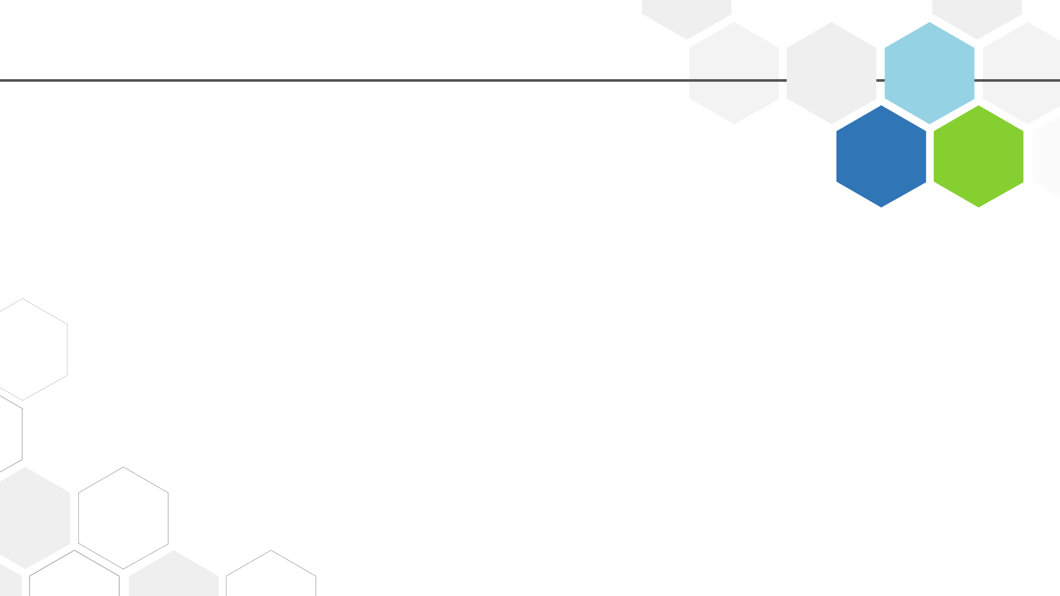
From data to knowledge
Nature, November 5, 2015
Data
Knowledge
Clinical applications
More than 200 bioinformatics researchers at SciLifeLab Stockholm
Mathias Uhlen

Slide 9
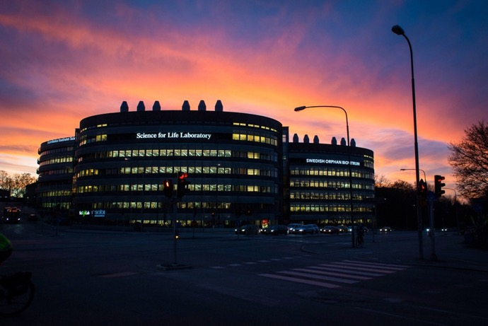
Content
The Human Protein Atlas
The Swedish SCAPIS SciLifeLab Wellness Program (S3WP)
The Human Secretome Project (HSP)
Science for Life Lab (Stockholm)
Center for molecular bioscience
National infrastructure
800 researchers

Slide 10
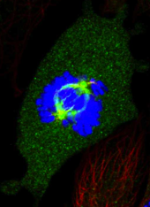
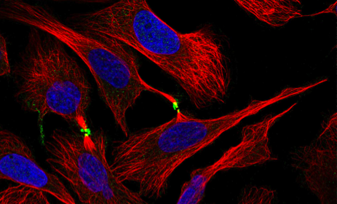
1. The Human Protein Atlas

Slide 11
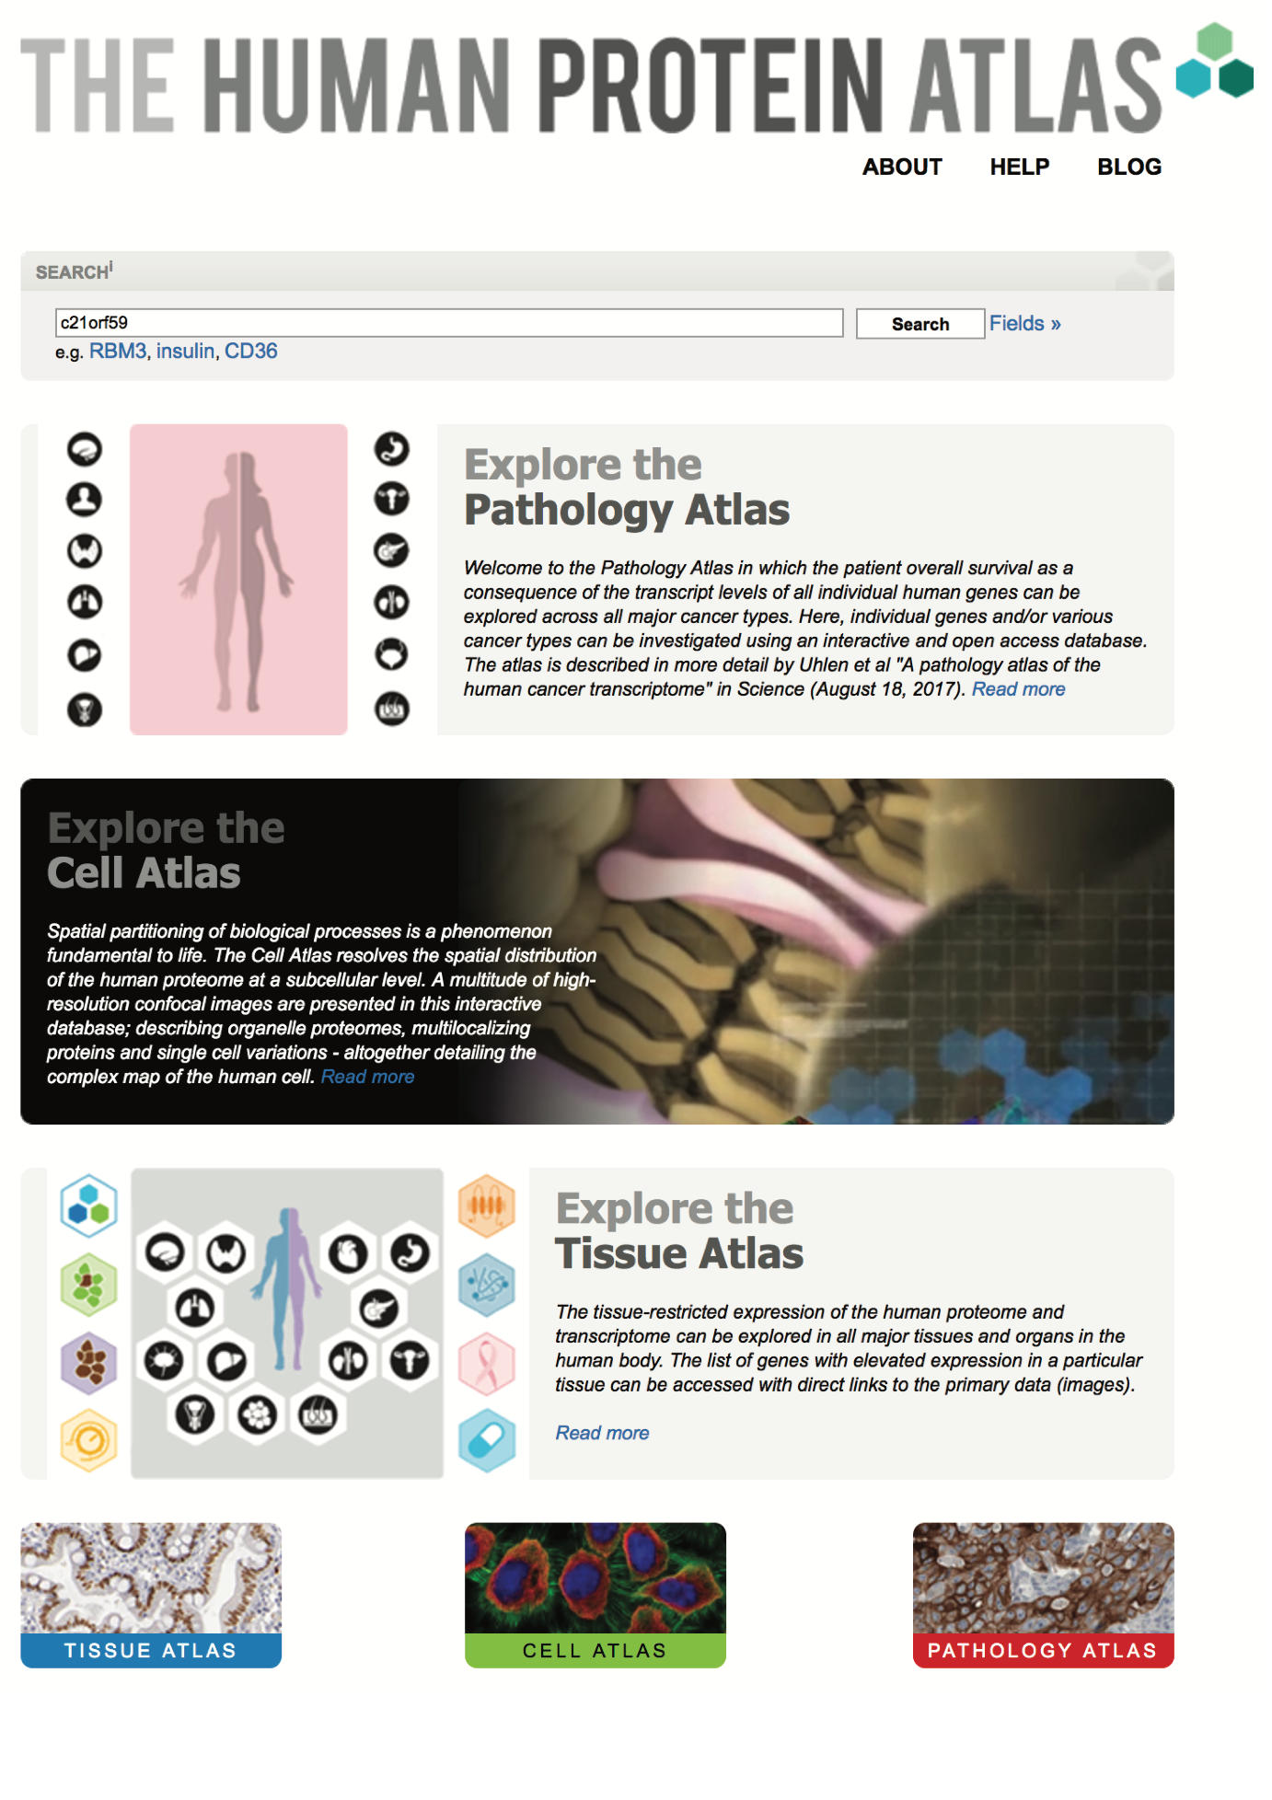

International effort to map all the human proteins with antibodies
More than 50,000 antibodies from more than 50 providers
Open access knowledge base
Focus on antibody validation

Slide 12
Human Protein Atlas - history
1995 First pilot project started
Chr 21 project started (Affibody)
2001. Chr 21 project closed
2002 Fund raising
2003 Start of KAW project (HPR)
2005 First launch (version 1)
New design (version 7) - HPA
Tissue Atlas (version 13)
Cell Atlas (version 16)
Pathology Atlas (version 17)

Slide 13
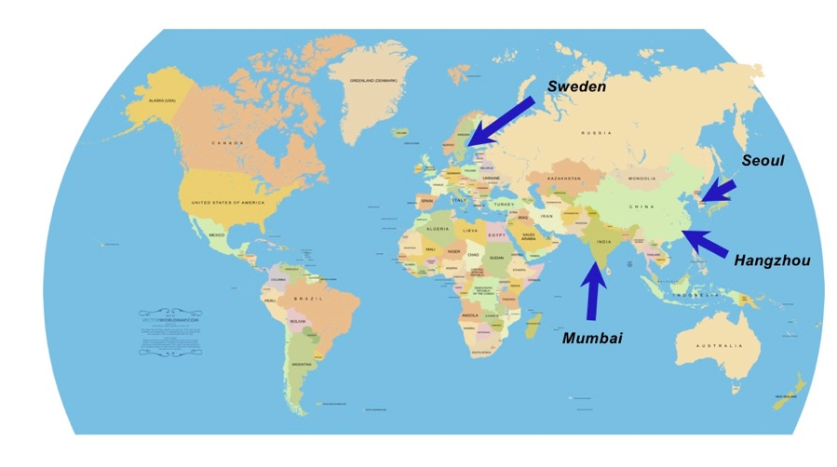
Started 2003
Mapping of the human 20,000 building-blocks (proteins)
>1500 person years
Knut and Alice Wallenberg Foundation
Director: Mathias Uhlen

Slide 14
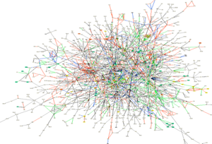
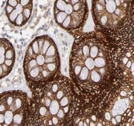
Central questions – the human proteome
How many proteins are expressed in a given cell ?
How many proteins are tissue-specific (i.e. brain) ?
Is an organ built up essentially by tissue specific proteins ?
What is the building-blocks of the cellular organelles ?
What are the targets for future drugs and diagnostics ?

Slide 15
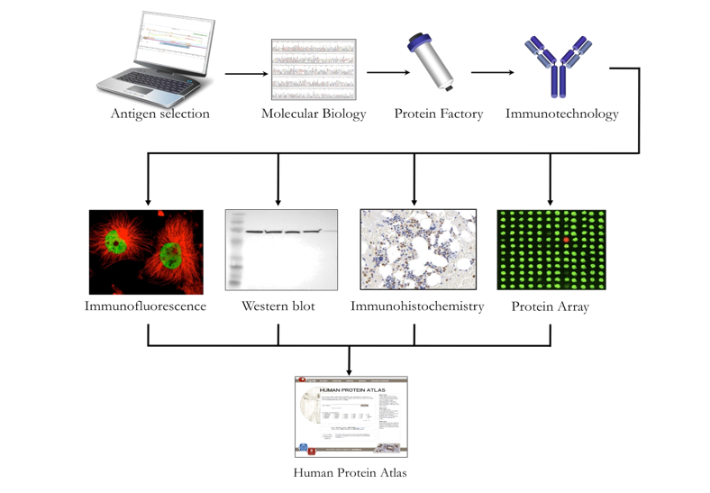
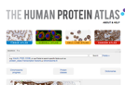
A Multi-Disciplinary Program
Antigen
generation
Antibody generation
Antibody validation
Protein expression profiling
PROTEIN ATLAS

Slide 16


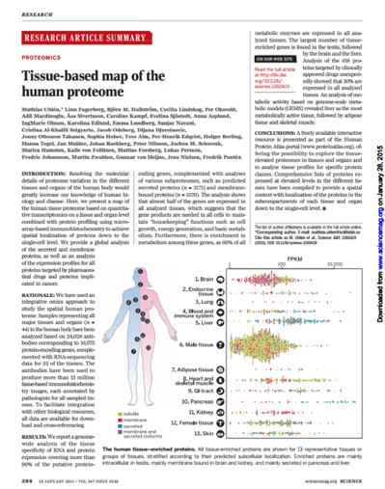
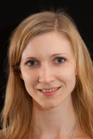
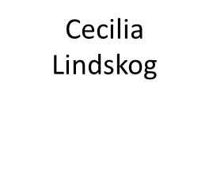
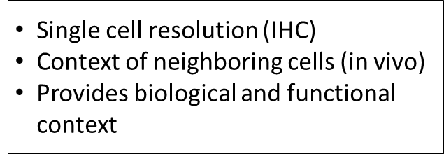
Tissue Atlas - Tissue profiling using antibodies
Uhlen et al (2015) ”Tissue-based map of the human proteome” Science 347: 394

Slide 17

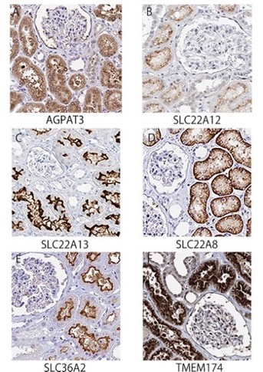
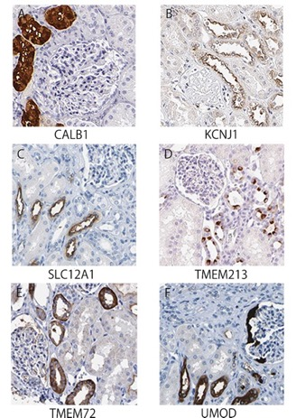
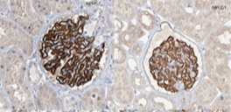
Proteins in human kidney
Proximal tubuli
Glomerus
Distal tubuli

Slide 18

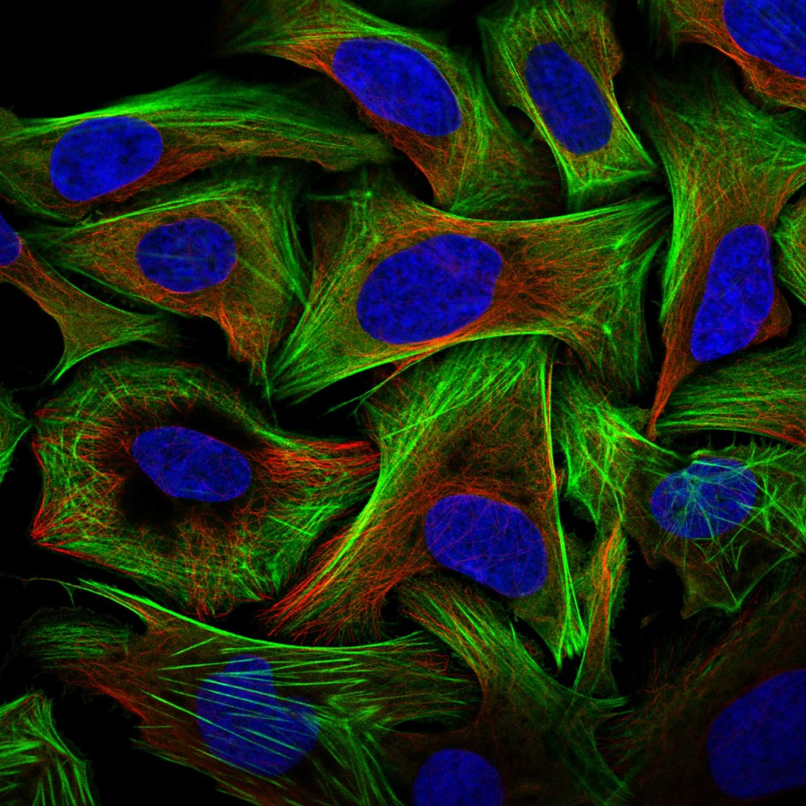
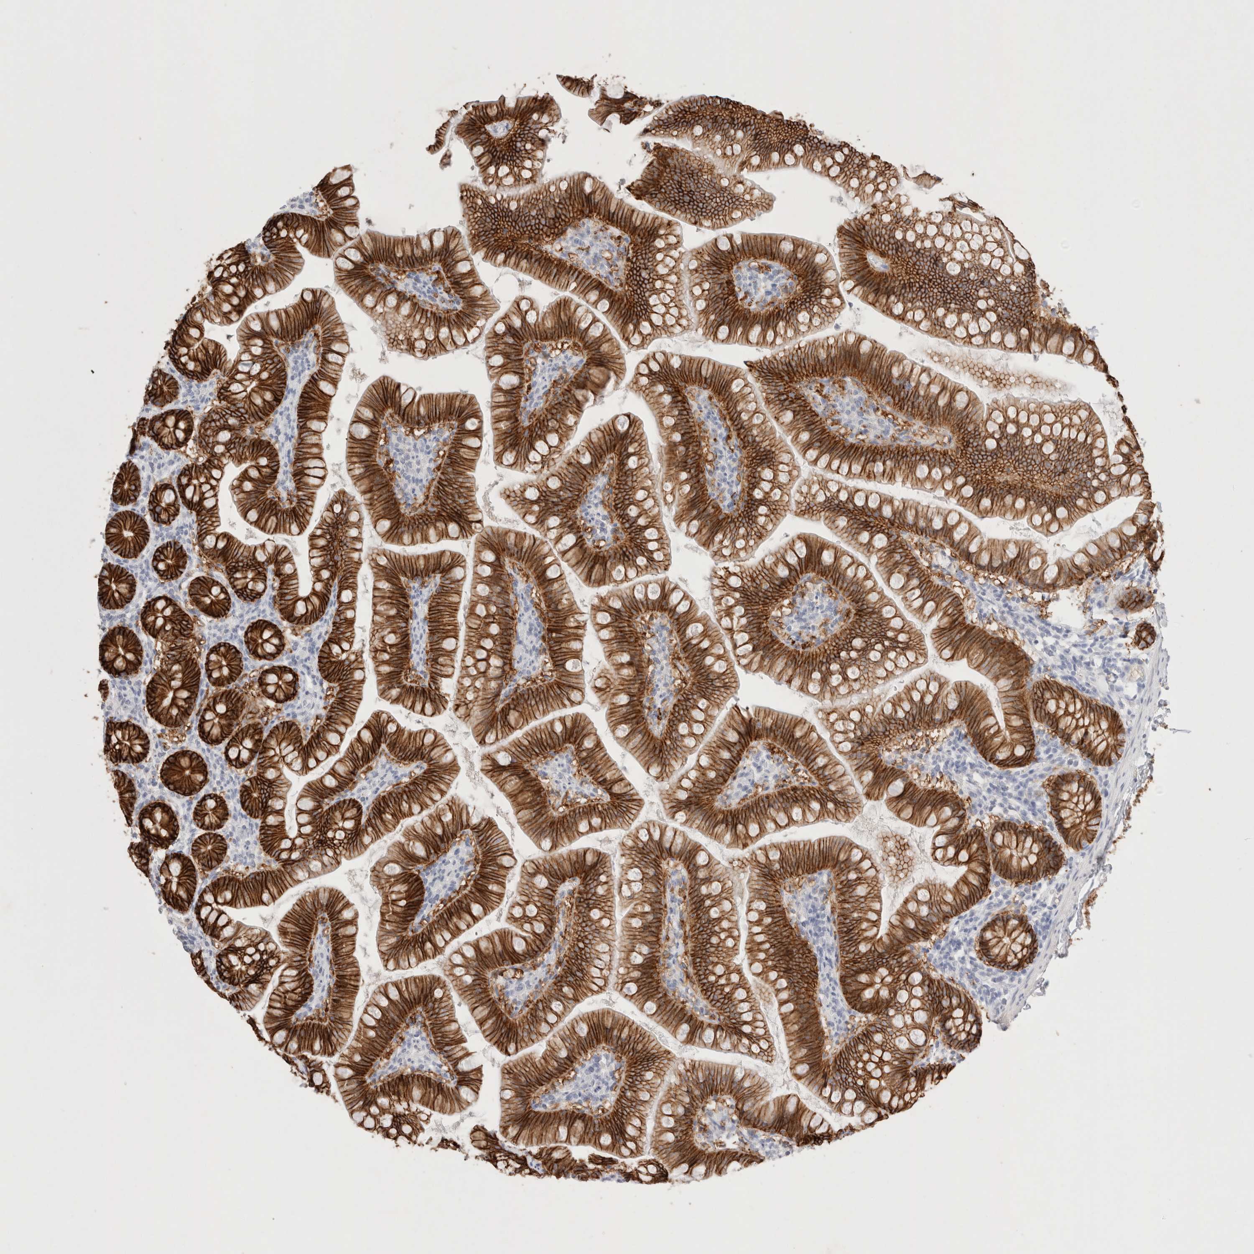

More than 10 million images

Slide 19


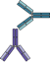
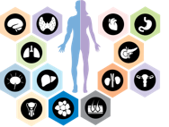
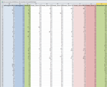
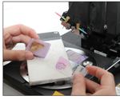
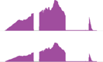
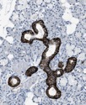
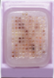
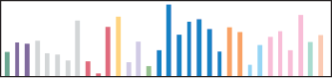
Analysis of the tissue proteome
using an integrated omics approach
Transcriptomics analysis of normal human tissues
Immunohistochemistry
on tissue microarrays
37 normal tissue types
44 normal tissue types
Tissue Atlas
Fresh frozen samples from 172 individuals
Biobank samples from
Uppsala University Hospital

Slide 20
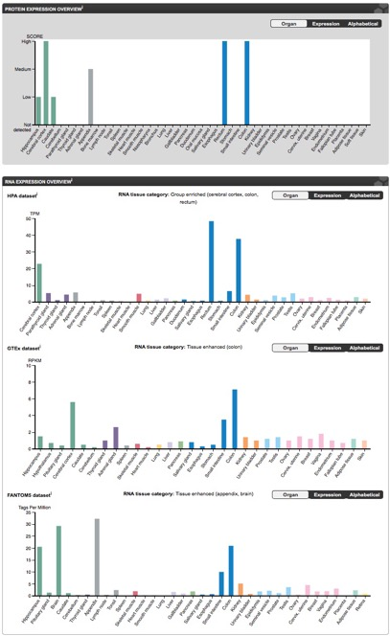
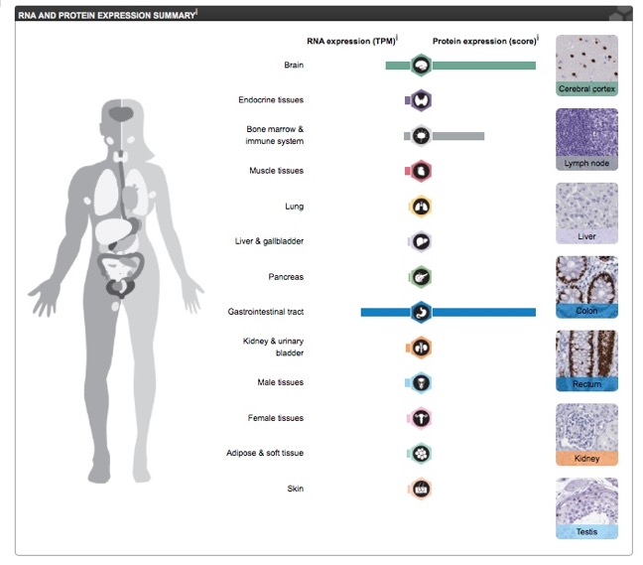
SATB2 expression
Protein (HPA)
mRNA (HPA)
mRNA (GTEx)
mRNA (FANTOM5)

Slide 21
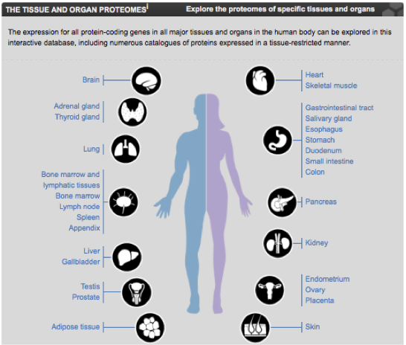
Human tissues and organs
Uhlen et al (2015) ”Tissue-based map of the human proteome” Science 347: 394

Slide 22
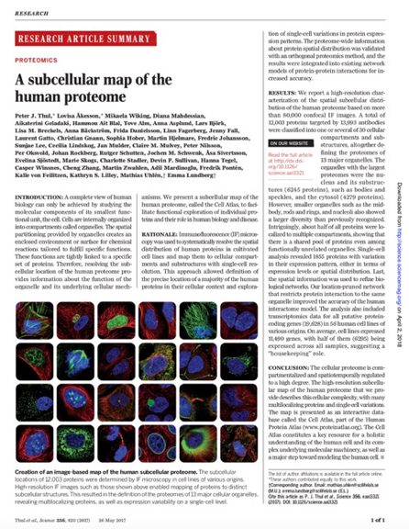


Cell Atlas - Subcellular profiling using antibodies
Subcellular resolution (confocal)
Single cell variation
Provides biological and functional context
Thul et al (2017) ”A subcellular map of the human proteome” Science 347: 394
Emma
Lundberg

Slide 23
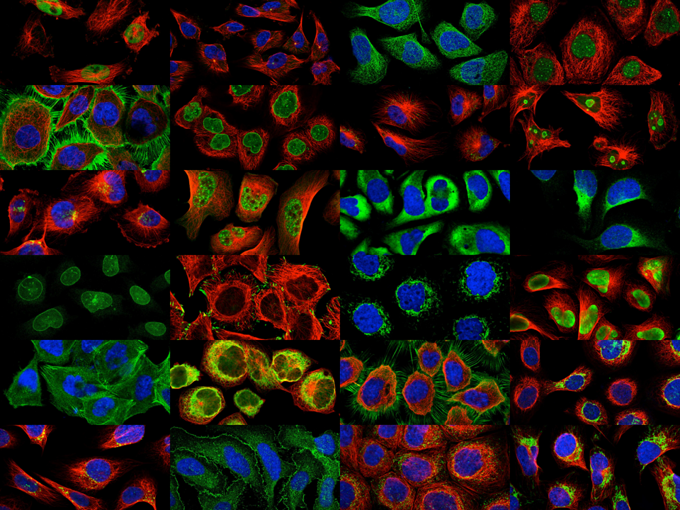
Cell Atlas
Where in the cell are proteins localized
Cell lines: U2OS + based on RNAseq
Fixation: Paraformaldehyde
Staining: HPA antibody
Nucleus (DAPI)
Micro-tubules
ER
Annotation: Manual

Slide 24

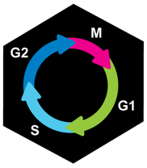
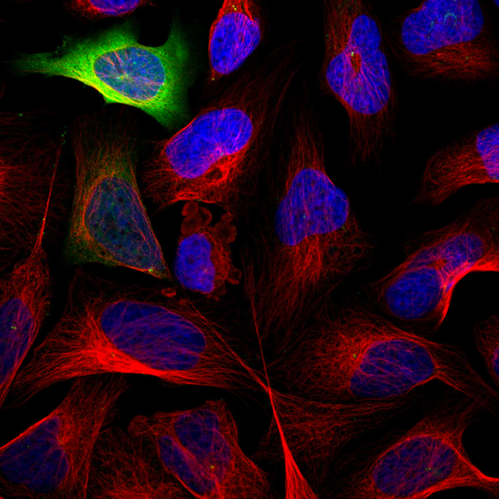
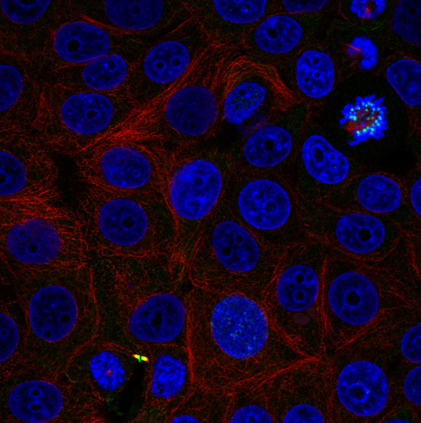
Cell to cell variations
CENTROMERE
CYTOKINETIC BRIDGE
Notes:
Most common for proteins localized to the nucleus, cytosol, mitochondria and nucleoli.

Slide 25
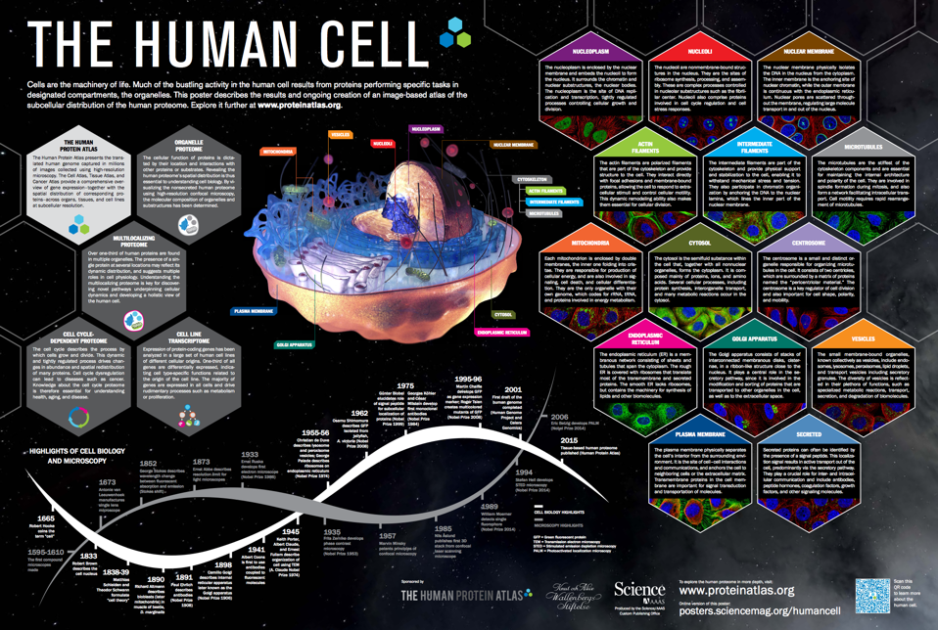

Slide 26



Pathology Atlas
Uhlen et al (2017) “A pathology atlas of human cancer proteomes” Science 357(6352)
Adil
Mardinoglu
Fredrik
Ponten

Slide 27


Slide 28


A large fraction of protein coding genes have an impact on average overall cancer patient survival
>10,000 genes are prognostic for at least one of the cancers
More than 800,000 plots visualized
Uhlen et al (2017) Science

Slide 29



Introducing Survival Scatter plots
Kaplan-Meier plot
Survival scatter plot
Survival
(living
years)
Gene expression

Slide 30

Path for precision medicine
Personalized genome-scale metabolic models (GEMs) for 6,753 patients and >4000 metabolites
The data allowed the generation of personalized genome-scale metabolic models for cancer patients to identify key genes involved in tumor growth
Uhlen et al (2017) Science

Slide 31
Summary – Pathology Atlas
Open access database (with more than 2,5 petabyte of underlying data)
“Big data” systems biology approach
Sharing of data important and should be encouraged
Uhlen et al (2017) “A pathology atlas of human cancer proteomes”, Science (August 18)

Slide 32

The Human Protein Atlas three separate parts
More than 1500 person years of research
Atlas | Description | Key publication
Tissue Atlas | Localization of proteins in human tissues and organs | Uhlén et al (2015) Science
Cell Atlas | Subcellular localization in single cells | Thul et al (2017) Science
Pathology Atlas | Prognostic genes for clinical outcome in cancers | Uhlén et al (2017) Science
Version 18 of the Human Protein Atlas launched December, 2017
Open access

Slide 33

Core Data Resource (ELIXIR)
Resources of fundamental importance to the wider life-science community and the long-term preservation of biological data (ELIXIR)
Open access (no restrictions)

Slide 34

Visitors from academia and industry
> 200,000 visitors per month
Open access

Slide 35

Geographic spread
Other
China
UK
Japan
Sweden
India
France

Slide 36
International Working Group for Antibody Validation
Uhlen et al (2016) A proposal for validation of antibodies. Nature Methods 13, 823–82

Slide 37
2. The S3WP program

Slide 38


Precision medicine
Right treatment to the right patient
Better diagnostic methods to probe health and disease

Slide 39



The Swedish SCAPIS SciLifeLab Wellness Profiling (S3WP)program
Vision
To define the “wellness profile” of individuals using state-of-the art molecular analyses
Combine “classical” diagnostics, advanced imaging and new “omics” technologies
Define important parameters for wellness profiling to be used in larger cohorts
Detect early signs of diseases
Guide individualized treatments

Slide 40


SCAPIS (Swedish CArdioPulmonary bioImage Study)
Research centers at six universities 30,000 men and women
PI Göran Bergström
Combines use of imaging technologies, large scale omics and epidemiological analyses
Designed to improve risk prediction of cardiopulmonary disease and optimize the ability to study disease mechanisms.
Bergstrom et al. The Swedish CArdioPulmonary BioImage Study: objectives and design. J Intern Med 2015.

Slide 41







SCAPIS base-line Imaging
Obesity
Emphysema
Dyslipidemia
Diabetes
Hypertension
Atherosclerosis
MI
Stroke
COPD
Visceral obesity (CT)
Liver steatosis (CT)
Coronary atherosclerosis (CTA)
Carotid atherosclerosis (US)
Pericardial fat
Carotid plaques
>2,5 mm (6-7%)
Carotid plaque morphology
(MRI)
Emphysema

Slide 42

Swedish SCAPIS SciLifeLab Wellness program (S3WP)
100 healthy volunteers from SCAPIS cohort with comprehensive base line data
Samples and questionnaires every 3 months during two years
Inclusion criteria
Randomly selected and included in the Gothenburg SCAPIS cohort.
50 but not yet 65 years of age at the time of selection
Exclusion criteria
Previously received health care for myocardial infarction, stroke, peripheral artery disease or diabetes
Presence of any clinically significant disease
Any major surgical procedure or trauma within 4 weeks of the first study visit
Medication for hypertension or hyperlipidemia
Questionnaires
140 questions on self-reported health, family history, medication, occupational and environmental exposure, lifestyle, psychosocial well-being, socioeconomic status
Food-frequency questionnaire (Mini-Meal-Q) with 35 questions

Slide 43

S3WP Wellness Profiling: clinical study
Visit 1 (Oct-Jan) IC, update questionnaire, FFQ*, anthropometry, BP, full WP**
Visit 2 (Jan-April) IC, update questionnaire, FFQ*, anthropometry, BP, activity, full WP**
Visit 3 (May-June) IC, update questionnaire, FFQ*, anthropometry, BP, activity, full WP**
Visit 4 (Aug-Oct) IC, update questionnaire, FFQ*, anthropometry, BP, activity, full WP**
101 individuals recruited – 99 came to the 4th visit (2 drop outs)
Josefin Kjelldahl
MarieLouise Ekholm
Notes:
43

Slide 44
The S3WP program
101 healthy volunteers from the SCAPIS cohort with comprehensive base line data (48 men and 53 women)
Multiple samples and questionnaires performed every three months during one year (visits 1-4)
Additional second year with two visits every six months (visits 5-6)
96 individuals came to the 6th visit

Slide 45
Weight and BMI distribution

Slide 46










SciLifeLab profiling
Affininty proteomics (plasma) Targted proteomics (plasma)
CYTOF (PBMC)
RNA seq (PBMC)
WGS (blood, once)
Metabolomics (plasma, Urine)
Proximity assay (plasma)
Microbiomics (Faeces 16S rRNA)
Clinical Chemistry (Blood)
Bioimpedance: _{Wrist band}
Multiple samples taken (blood, urine, feces) every third month

Slide 47

Comprehensive analysis of health
100 individuals analyzed every three months for two years

Slide 48

Clinical chemistry

Slide 49
Global profiles – clinical chemistry (n=31)
Global profiles (t-SNE) for 99 individuals during one year

Slide 50


S3WP Omics Program
Whole genome sequencing (DNA from blood)
Transcriptome (mRNA in PBMC)
Microbiome (feces)
Proteomics (ProSeek)
Blood cell status (CyTOF) (PBMC)
Proteomics (automimmunity)
Proteomics (Luminex)
Proteomics (QPrESTs)
Metabolomics (Umeå)
Systems biology (Chalmers, Stockholm)

Slide 51


Data warehouse wellness profiling
Clinical data
Anthropometry (weight, height, fat, hip etc)
Clinical chemistry and hematology variables (31 variables)
Questionnaire (lifestyle changes, health status, antibiotics)
Medical imaging data (MRI, US, stenosis, plaque etc)
Activity (sleep, steps, activity, exercise info)
WGS (variability)
RNA-seq (12,297 detected genes)
CYTOF (115 cell types)
Olink Proseek (11 panels, 750 proteins)
Autoantibody reactivity profiling
Microbiome (16s RNA and metagenomics)
Targeted proteomics (100 proteins)
Metabolomics and lipidomics
Extensive questionnaires (food, travel, diseases, social etc)
0,5 petabyte of processed data
Linn Fagerberg

Slide 52



Auto-immunity profiles (n=349)
Auto-antibodies
in blood
Maja Neiman
Peter Nilsson

Slide 53


Global profiles – metabolome (n=1490)
Metabolites in blood (LCMS)
Thomas Moritz

Slide 54

Global profile – immune cytome (n=117)
Petter
Brodin
117 cell types (CyTOF)
39 million cells annotated

Slide 55

Plasma profiling - technology platforms
Initiative | No of targets | Status
Luminex (suspension beads) | 2000 | National facility (Solna)
Olink (padlock probes) | 750 | National facility (Solna)
Target proteomics (mass spectrometry) | 200 | ”In-house” development

Slide 56



Antibody-based proteomics profiling
Leptin
Folate Receptor 3
Olink multiplex panels based on proximity extention assay (PEA)
397 samples run in 11 panels
Longitudinal and quantitative data for ~1000 proteins
Linn Fagerberg
Leptin
r=0.89
Folate Receptor 3
r=0.99
Fagerberg et al. Submitted

Slide 57

Protein plasma levels related to BMI, weight, waist and fat
50 most significant proteins
Notes:
Linear mixed effect modelling

Slide 58

17 kg weight loss in three months
Positive correlation
Negative correlation

Slide 59


Protein plasma levels related to infection (high CRP)
50 most significant proteins
Subject with high CRP in one visit

Slide 60

Variability of proteins in plasma

Slide 61

Global profiles – plasma proteome
Protein profiles
in blood (n=750)

Slide 62

Mixed effect modelling (OPLS)
Notes:
Unique molecular fingerprint

Slide 63

Integrative studies (Mixed effect modeling, OPLS)

Slide 64

Global molecular profiles during one year
Notes:
Unique molecular fingerprint

Slide 65




Global profiles for individuals during one year
Notes:
Unique molecular fingerprint

Slide 66











Acknowledgements
Göran Bergström
Anders Gummesson
Ina Schuppe Koistinen
Linn Fagerberg
Jacob Odeberg
Lars Engstrand
Per-Anders Jansson
Fredrik Bäckhed
Maja Neiman
Peter Nilsson
Jochen Schwenk
Petter
Brodin
Thomas Moritz
Fredrik Edfors
Sanela
Kjellqvist
Adil
Mardinoglu
Mathias Uhlén

Slide 67
3. The Human Secretome Project (HSP)

Slide 68


Secreted proteins – therapeutic targets
The Human Blood Secretome
Actively secreted proteins
Biological function
Excluding leakage proteins
How many ?
Notes:
----- Meeting Notes (9/29/15 02:46) -----
16 min

Slide 69
How many proteins in the human secretome?
3526 possibly secreted genes
HPA secreted
(2933)
Uniprot secreted
(2038)
Remove
- low priority targets: immunoglobulins
- genes with low evidence: HPA secreted w/o secreted tsl1
- genes not mapped to ensembl
1471
1462
593
2619 possibly secreted genes for annotation

Slide 70

Annotation effort – purpose built LIMS
Objective to annotate all 2619
Annotation tool in LIMS

Slide 71

New annotation of the human secretome (October 1, 2018)

Slide 72


The human secretome project
Overall objective:
Production of all human secreted proteins
High-throughput production in CHO cells
Create a resource of reagents for drug discovery and development
Co-funding:
Knut and Alice Wallenberg Foundation (WCPR)
Novo Nordisk Foundation (CFB)
AstraZeneca (MedImmune)
Royal Institute of Technology (KTH)

Slide 73


Producing the entire human secretome in CHO

Slide 74

Produced so far in the secretome project
3075 genes synthesized
1407 proteins succesfully finished (with QC)

Slide 75

Omics analysis of CHO production

Slide 76



AstraZeneca phenotypic assays (n=788)

Slide 77

Kidney regeneration assay (n=788)

Slide 78

Use of secretome resource

Slide 79

Conclusions - the Human Secretome Project
1400 bioactive proteins comprised of secreted and extracellular protein domains have been produced .
A phenotypic assay in primary human fibroblasts to model disease progression in chronic kidney disease has been designed and used.
The application of the secretomics library to this phenotypic model has successfully identified three families of proteins that modulate fibroblast biology by different mechanism.

Slide 80
Concluding remarks

Slide 81

Human Protein Atlas program – major launches
Atlas | Launch | Relevance for scientific community
Tissue | 2015 | Where are proteins located in the human body (tissues and organs)
Subcellular | 2016 | Where are proteins located in the cell (organelles and compartments)
Pathology | 2017 | What proteins have consequence for clinical outcome in cancers
Metabolic* | 2018 | What metabolic pathways are present in different tissues and diseases
Brain | 2019 | Where are proteins located more specifically in the brain
Blood | 2019 | What proteins and cells are present in blood under normal and pathology conditions
Microbiome* | 2019 | What microbes are present in healthy and disease gut
* These will primarily be separately dedicated atlas with many links to HPA

Slide 82

Take-home messages
New tools make it possible to systematically study the buildings-blocks of humans
Large parts of medical research is data- and technology-driven
The Human Secretome Project – annotated all proteins actively secreted to human blood
Precision medicine based on omics attractive for the future

Slide 83





Funding
Wallenberg Foundation (Human Protein Atlas project)
Novo Nordisk Foundation (Center for Biostainability)
Erling Persson Foundation (Precision medicine)
Heart and Lung Foundation (Biobank profiling)
Chan Zuckerberg Foundation (Human Cell Atlas)
ELIXIR – sharing of data resources

Slide 84

Acknowledgement
Emma Lundberg (Stockholm)
Fredrik Edfors (Stockholm)
Linn Fagerberg (Stockholm)
Jochen Schwenk (Stockholm)
Peter Nilsson (Stockholm)
Jan Mulder (Stockholm)
Fredrik Ponten (Uppsala)
Cecilia Lindskog Bergström (Uppsala)
Hanna Tegel (Stockholm)
Johan Rockberg (Stockholm)
Sophia Hober (Stockholm)
Adil Mardinoglu (Stockholm)
Jens Nielsen (Göteborg)
Veronique Chotteau (Stockholm)

Slide 85

HPA-annual-Visby - 2018

Slide 86





mathias.uhlen@scilifelab.se

